Slide 1
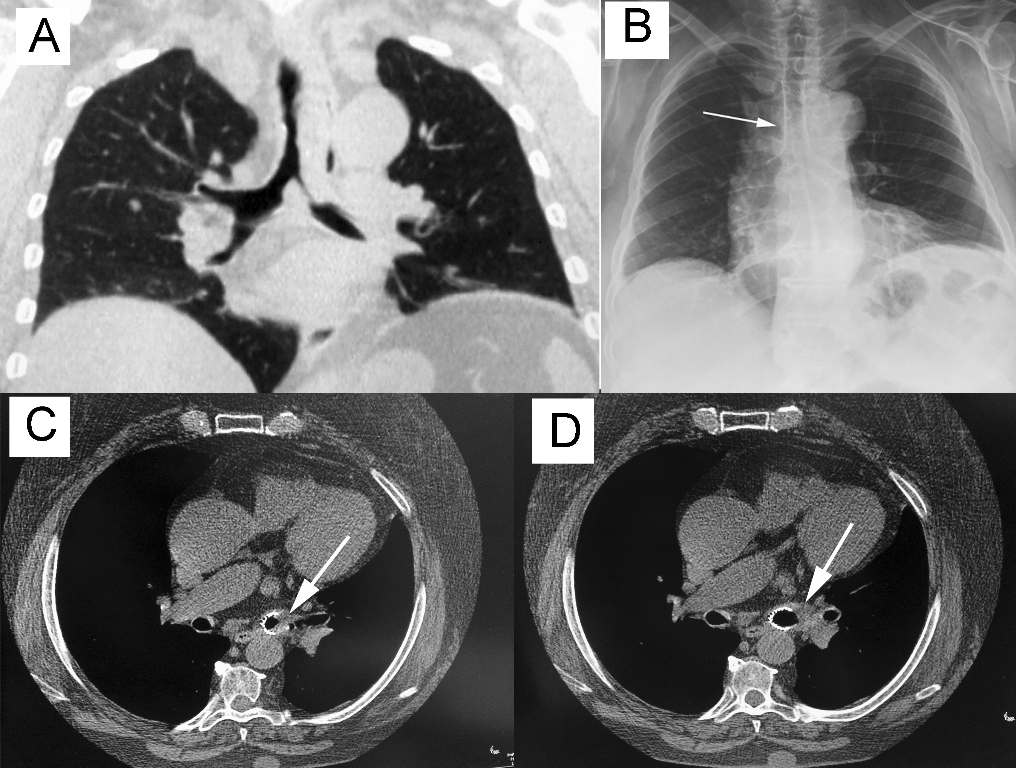
Figure 1: An amyloid mass obstructed the distal trachea and the mainstem left bronchus (Part A). After its resection via rigid bronchoscope, a Y-shaped covered, self-expandable metallic stent was inserted to assure airway patency (Part B). Twelve months after, a recurrence of amyloid tissue obstructed the distal end of stent within left bronchus (white arrow, Part C). A mechanical resection associated with Nd/YAG laser irradiation of amyloid allowed to restore the air-way patency of left bronchus (white arrow; Part D).

