Slide 1
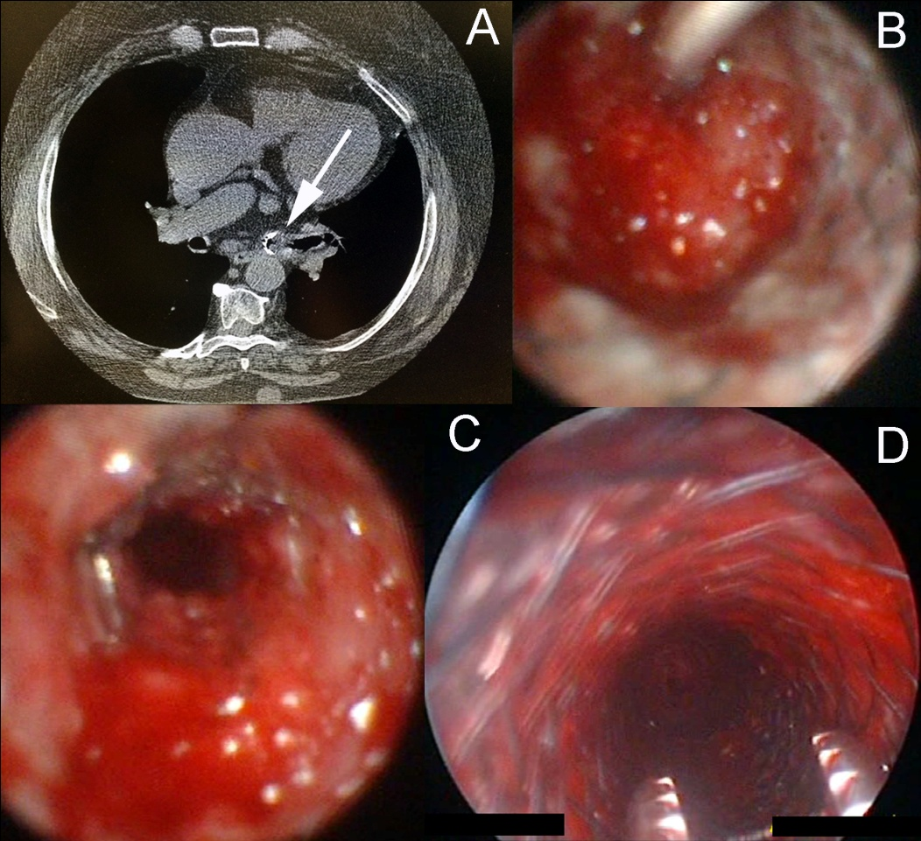
Figure 2: Exophitic amyloid tissue obstructed the proximal end of Y-stent in trachea and the distal end of Y-Stent within left bronchus (white arrow, Part A). The delivery catheter of self expanded metallic stent (SEMS) was introduced in the lumen of left bronchus (Part B). The placement of SEMS restored the airway patency of left main bronchus (Part C). Another SEMS was placed in the proximal trachea (Part D).

