Slide 1
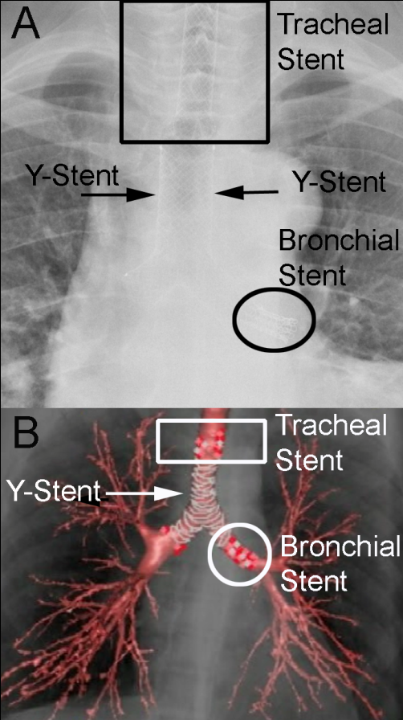
Figure 3: Chest-X-ray (Part A) and Computed tomography scan with 3D reconstruction (Part B) showed the presence of Y-Stent and of the additional two SEMSs within trachea and left main bronchus (Part B). Notably, the complete re-expansion of both lungs without sign of atelectasis.

